Slide 1
EPWG Quarterly Presentation
OEM
9/30/2025
1

Slide 2
Introduction
“Helping People Before, During, and After Disasters” is the core purpose of the Governor's Office of Emergency Management / Homeland Security (OEM). Our mission is to prepare Nevada for emergencies, coordinate response efforts, and support recovery to build a more resilient state. Through collaboration and partnerships, we strive to foster a solution-oriented culture and a team environment that attracts and retains talented individuals by prioritizing care and support for our people. OEM leads statewide coordination of federal and state homeland security and emergency management programs. We oversee disaster relief and emergency assistance efforts to ensure efficient mitigation, preparedness, response, and recovery for natural, man-made, or technological emergencies. Our work includes liaising with federal, state, local, and tribal agencies to administer emergency management and homeland security initiatives. Key responsibilities include:
Coordinating resources and equipment for intra- and inter-state mutual aid.
Developing and implementing Nevada’s emergency management strategic direction.
Leading, participating in, or supporting commissions, committees, and boards as required by Nevada Revised Statutes (NRS) Chapters 414 and 239C.
Established in 1953 under NRS Chapter 414, OEM has a long history of serving Nevadans. On July 1, 2021, Governor Steve Sisolak signed Assembly Bill 485 into law, transitioning OEM from the Department of Public Safety to the Office of the Military.
Today, OEM continues to lead the charge in building a safer, stronger, and more resilient Nevada through effective coordination, collaboration, and service.
2

Slide 3
OEM EPWG Funding
Funding | 2021-2024 | 2025 | 2026
Awarded | $123,000 Over 5 years | Additional $250,000 from balance forward
Spent | $47,048.12 | $133,274.8 | $57,490.78
Balance | $75,951.88 | $192,677 | $135,186
3

Slide 4
4

Slide 5


OEM EPWG Expenditures
Payroll
Radiological Detection Devices
Radiological Detection Badges (Mirion)
Program Supplies
Freight(Ludlum For Device Repair)
Communications
Travel
Civil Support License
5

Slide 6
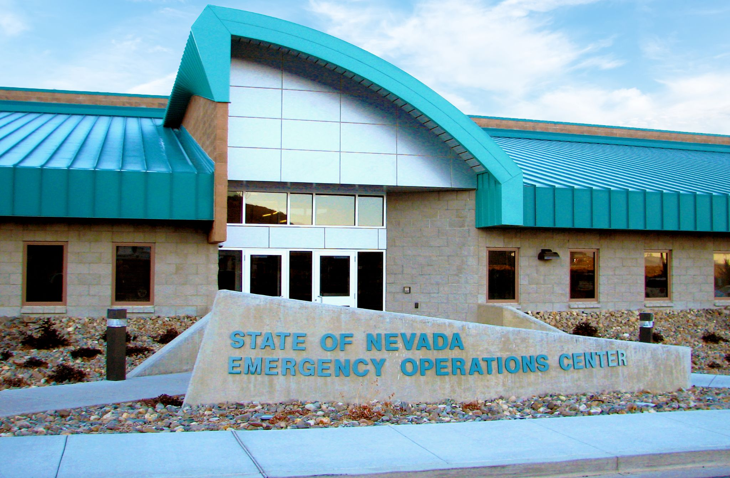





Thank You.
Jared Franco
775-434-4432
jaredfranco@dem.nv.gov
www.dem.nv.gov
@NvEmergencyMgmt
6

