Slide 1

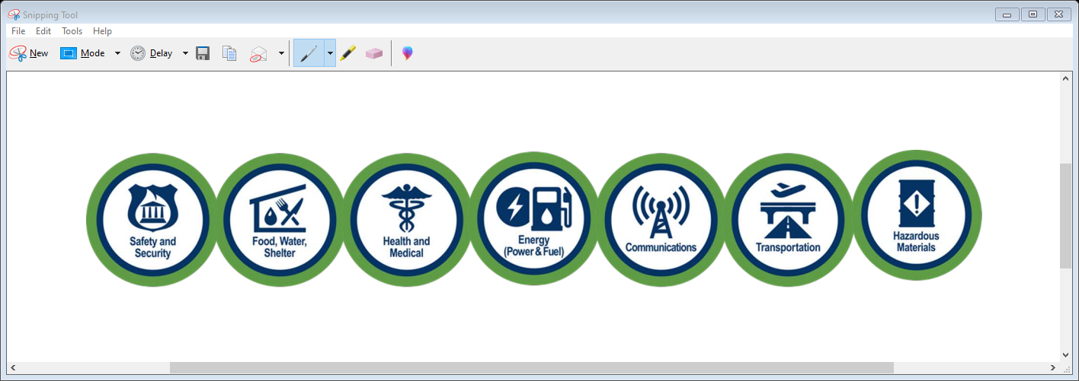
DEM Duty Officer – 775-687-0498
Bill Elliot
WEEKLY SITUATION REPORT
SEOC Activation Level
PARTIAL
FIRE PREPAREDNESS LEVELS
NEVADA | NATIONAL
PREPAREDNESS LEVEL 1 | PREPAREDNESS LEVEL 1
April 19 | MGT-471 Executing Strategies to Rapidly Rehabilitate Damaged Housing - Virtual | April 27-29 | G300 Intermediate Incident Command System - Winnemucca
April 25 -29 | L0967 All Hazards Position Specific Logistics Section Chief – Las Vegas | April 30 | Nevada Land Search Management Course – Minden
April 26 - 28 | Auxiliary Communications (AUXCOMM) - Reno | May 10 | Southern NV EOC/MACC Standardization Course - Henderson
To register for courses, please visit the Nevada Training & Qualification System
NATIONAL WEATHER SERVICE
Reno | Las Vegas | Elko
COVID-19 RESOURCES
Nevada Health Response | Nevada 211 | COVID-19 | NVCovidFighter
Washoe County Health District | Southern Nevada Health District | CCHHS - Quad Counties

